Slide 1
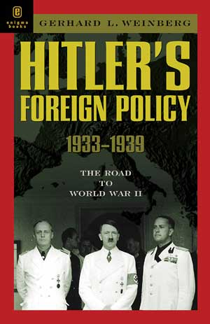
Nazi Germany
Foreign Policy

Slide 2
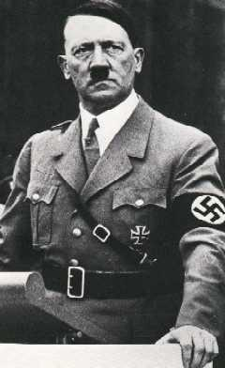
Foreign Policy Aims
Hitler and the Nazi Party believed
in building a strong German
Empire, they actively opposed the
Weimar Republic’s policies and
were embarrassed by the outcome
of World War I.
The Nazis used these ideals to
gain support within the public and
in 1934 Hitler became the Fuhrer.
Hitler’s foreign policy was
therefore based on the points which follow

Slide 3
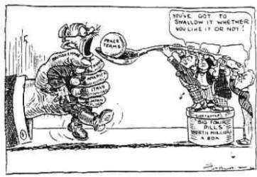
Foreign Policy Aims
Hitler wanted to destroy the Treaty of Versailles: the Treaty was seen as a great embarrassment to Germany, Hitler had built his political reputation on the promise he would overturn it. This would help Hitler rearm Germany and remilitarise the Rhineland.

Slide 4
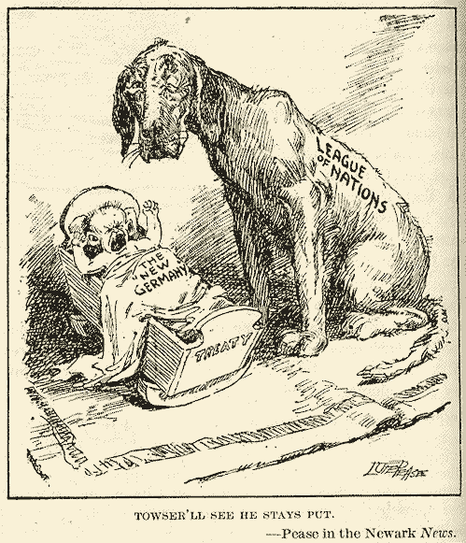
Foreign Policy Aims
2. Removal of Germany from the League of Nations: Hitler aimed to expand the German empire and change the boundaries of nations that the peace treaties and the League had protected for so long.

Slide 5
Foreign Policy Aims
3. Lebensraum: Hitler need ‘living space’ for his ‘master race’, the Aryans. In order to achieve this he needed the territory to expand into.
4. Greater German Reich: Hitler wanted to create a master German race, by uniting all German speaking peoples, in particular Austria.

Slide 6
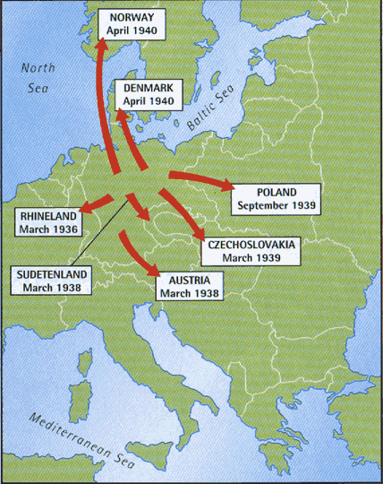
Foreign Policy Aims
5. Attack and Invade the Eastern Europe and Russia: There were several reasons for Hitler wanting to do this;
He wanted to use this land to achieve ‘lebensraum’ and Eastern Europe and Russia were close targets.
He could ‘cleanse’ Europe of Communists and racial inferiors, particularly the Jews.

Slide 7
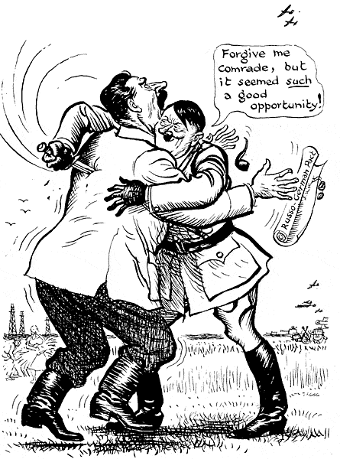
Foreign Policy Aims
(5 continued)
He realised he needed to eliminate any states which may be ‘unfriendly’ towards Germany, in particular Poland and Czechoslovakia.
He also believed that strong empires need certain goods to survive, including food and raw materials both of which could be found in Eastern Europe and Russia. He promoted ‘autarky’

Slide 8
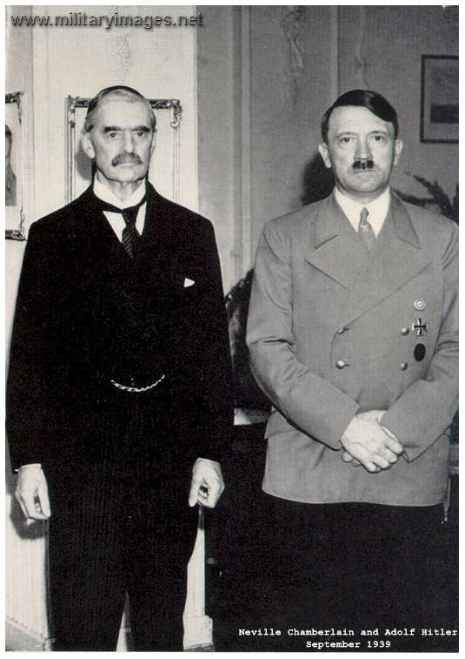
Foreign Policy Constraints
There were some constraints to Hitler’s foreign policy:
Hitler knew that there would be opposition from Britain and France over his aims.
France however was not considered to be a military threat while Hitler believed Britain and Germany were natural allies.
He also used the British and French’s suspicion of Communism to exaggerate the threat of Russia.

Slide 9
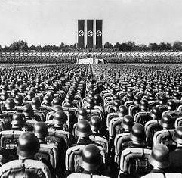
Foreign Policy Constraints
(continued)
He also needed to be cautious as Germany was relatively weak economically and had few allies. Hitler had to represent all his actions as being in the interests of peace, also promising each change would be his last!
Germany had a weak military
i. 100, 000 men in the army
ii. No air force
iii. No tanks
iv. No battleships, U-boats, aircraft carriers

Slide 10

This was an outline of Hitler’s foreign policy aims, now we are can look at Hitler’s ‘steps to war’.

